Slide 1
Integration and Evaluation of Kubernetes and Docker swarm in combination of Docker Compose
Master Thesis
Presented By: Tanzeem Md Zillu
Matriculation No: 1099269

Slide 2
Discussion topics
Introduction
Docker swarm
Kubernetes
Use cases
Conclusion and future scope

Slide 3
Introduction
What is Container?
A container image is a lightweight, stand-alone, executable package of a piece of software that includes every-thing needed to run it: code, runtime, system tools, system libraries, settings.

Slide 4
Introduction
Container Architecture

Slide 5
Introduction
Container vs Virtual Machine

Slide 6
Introduction
Container Orchestrator

Slide 7
Introduction
Container Orchestrator for this thesis work
Docker Swarm
Kubernetes

Slide 8
Docker Swarm
What is Docker Swarm?
Docker swarm is the cluster management and orchestration features embedded in the Docker Engine are built using SwarmKit. Docker engines participating in a cluster are running in swarm mode.

Slide 9
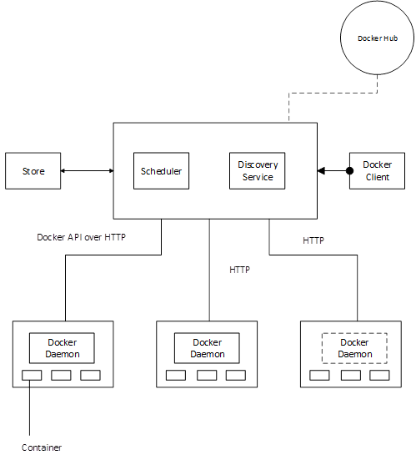
Docker Swarm
Docker Swarm Architecture

Slide 10
Kubernetes
What is Kubernetes?
Kubernetes is an open-source system for automating deployment, scaling, and management of containerized applications. It groups containers that make up an application into logical units for easy management and discovery.

Slide 11
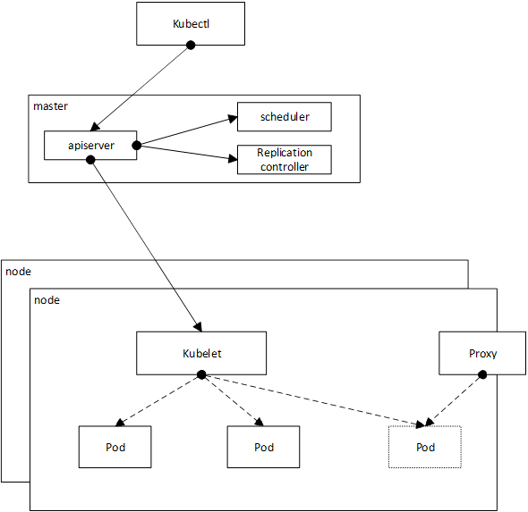
Kubernetes
Kubernetes Architecture

Slide 12
Use Cases
Setting up cluster
Networking in between cluster
Deployment of application
Auto scaling of application
Load Balancing
Container update and Rollbacks
Live migration
Performance analysis

Slide 13
Use Cases
Containerized applicattion used
Web application prints the container/pod id
Web server based on Apache tomcat
Database server based on MySQL
Prime number counter which counts all prime number between 1 million

Slide 14
Use Cases
Setting up cluster

Slide 15
Use Cases
Networking in between Cluster

Slide 16
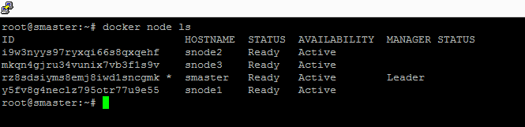
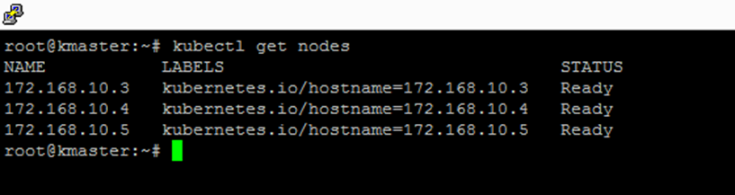
Use Cases
The cluster status
Cluster status of docker swarm
Cluster status of kubernetes

Slide 17
Use Cases
Deployment of Application

Slide 18
Use Cases
Deployment of Application
In docker swarm it is possible to create global service and replicated service
In kubernetes it is possible to deploy the application in a specific node

Slide 19
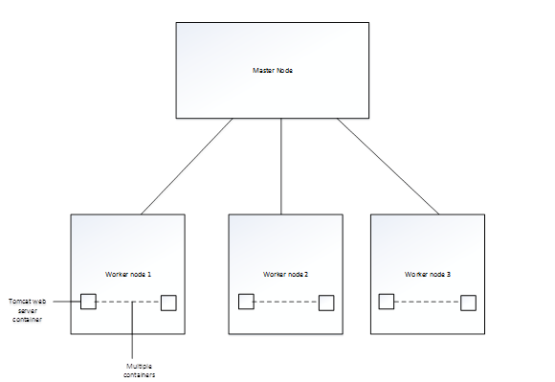
Use Cases
Auto scaling of application

Slide 20
Use Cases
Auto scaling of application
In both cases it is possible to scale a running service
Also user can define how many containers he/she wants during creating replicated service.

Slide 21
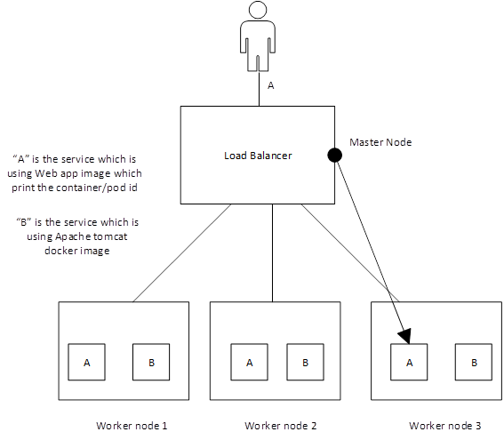
Use Cases
Load Balancing

Slide 22
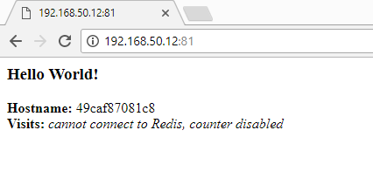
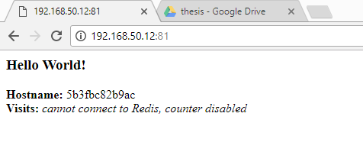
Use Cases
Load Balancing

Slide 23
Use Cases
Load balancing
Docker swarm uses built in ingress load balancing system.
In kubernetes two types of internal load balancing facilities are available which are NodePort and LoadBalancer.
External load balancing facilities is possible to use in both orchestrator.

Slide 24
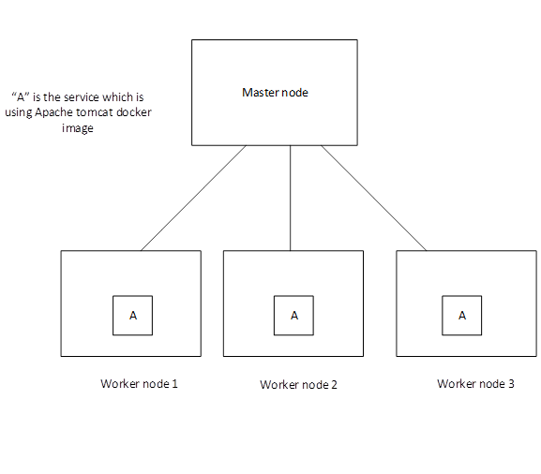
Use Cases
Container update and rollback

Slide 25
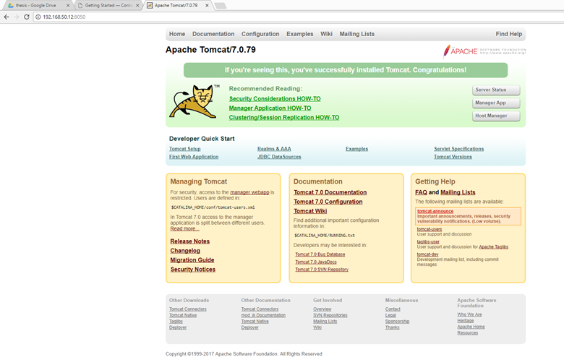
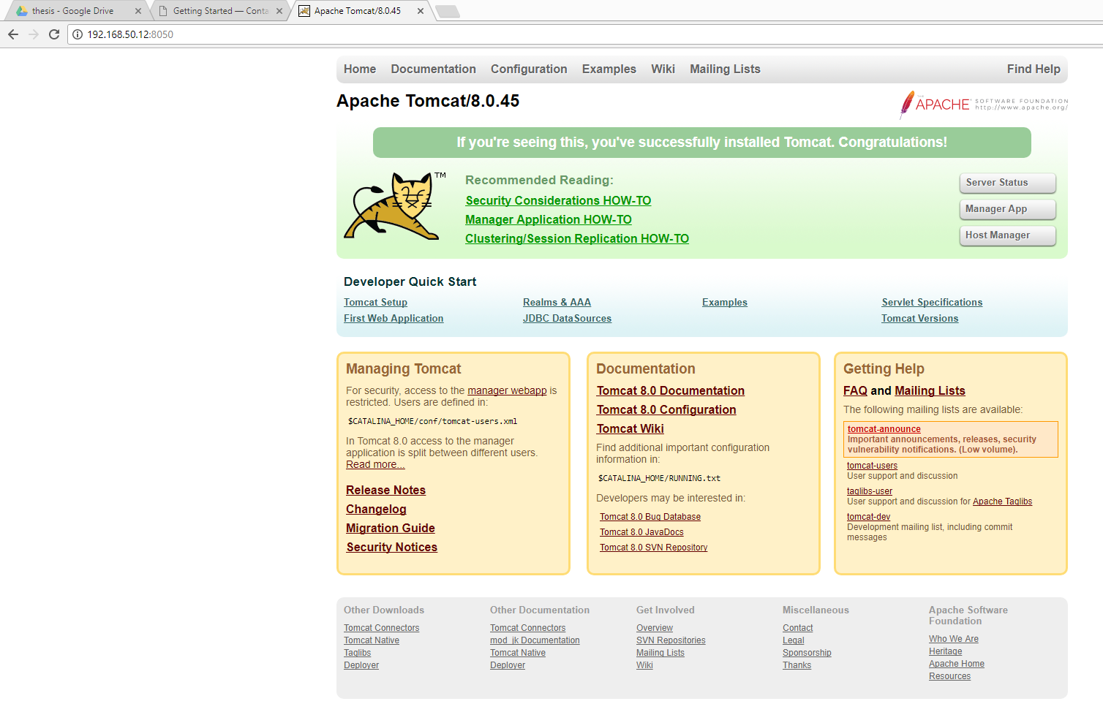
Use Cases
Container update and rollback

Slide 26
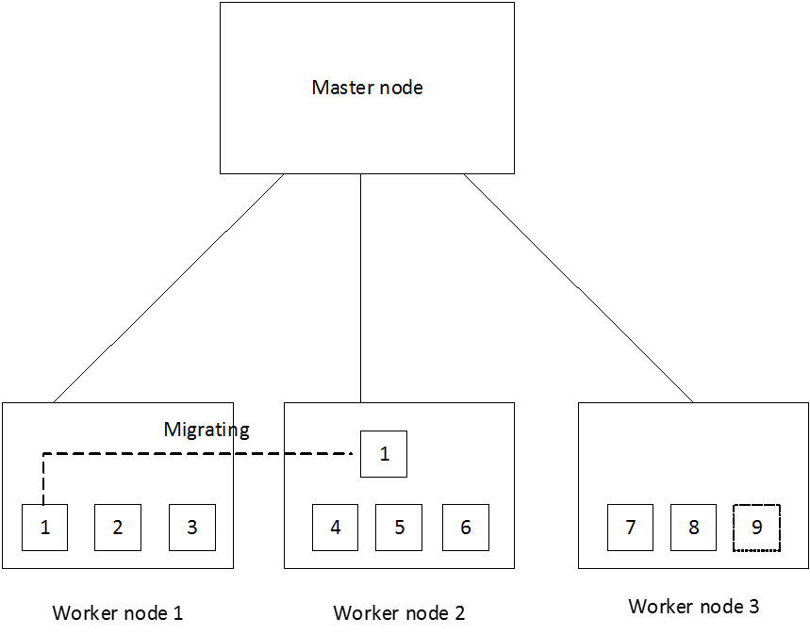
Use Cases
Live Migration

Slide 27
Use Cases
Live Migration
Either docker swarm neither kubernetes does not support live migration.

Slide 28
Use Cases
Possible way to serve Migration in Kubernetes

Slide 29
Use Cases
Performance Analysis
For this use case an application has developed which counts all the prime number between 1 million

Slide 30
Use Cases
Performance Analysis
docker run -d --name='high_prio_prime' –cpuset cpus=0 --cpu-shares=80 tanzeemzillu/tanzeemzillu:primenumber md5sum /dev/urandom
docker run -d --name='low_prio_prime' --cpuset-cpus=0 --cpu-shares=20 tanzeemzillu/tanzeemzillu:primenumber md5sum /dev/urandom

Slide 31
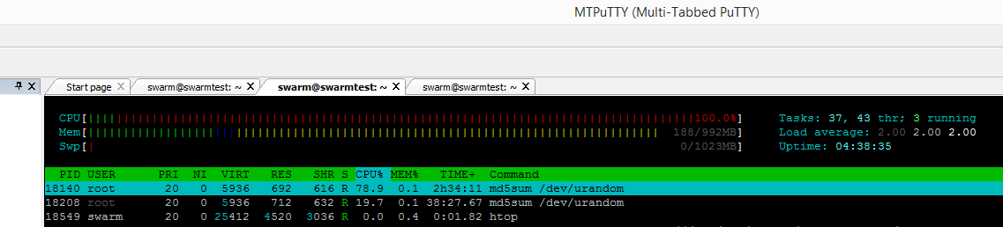
Use Cases
Performance Analysis

Slide 32
Conclusion and future scope
Evaluation between Docker swarm and Kubernetes

Slide 33
Conclusion and future scope
From the above discussion, it is seen that both orchestrator has some advantages and disadvantages. It depends on the user which one he/she prefers. But in many cases, it is useful to have both the facilities. So, in this situation Rancher can be handy

Slide 34
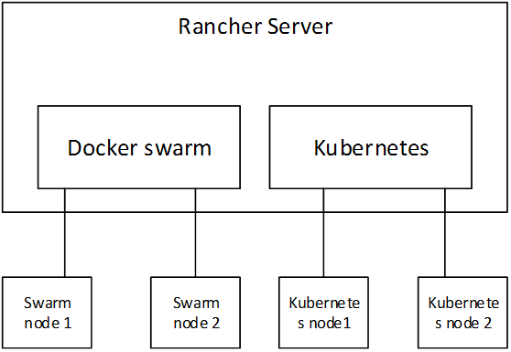
Conclusion and future scope
Rancher

Slide 35
Conclusion and future scope
Future Scope to do Migration

Slide 36
Conclusion and future scope
Future Scope
How many containers can be scaled
How many nodes supported by a orchestrator
Health checking and monitoring of containers

Slide 37
Thank You !!

